Slide 1
WB Carbon Monitor Cities
Region Boundary and LCZ maps
C.Z., M.C., 2022

Slide 2
Contents
Preparation
Concept
Datasets
Regions
Grid emission map versions
V0: polygon based
V1: gridded map with no time variance
V2: gridded map with time variance
V3: map refined with building details from ML models
Uncertainty

Slide 3
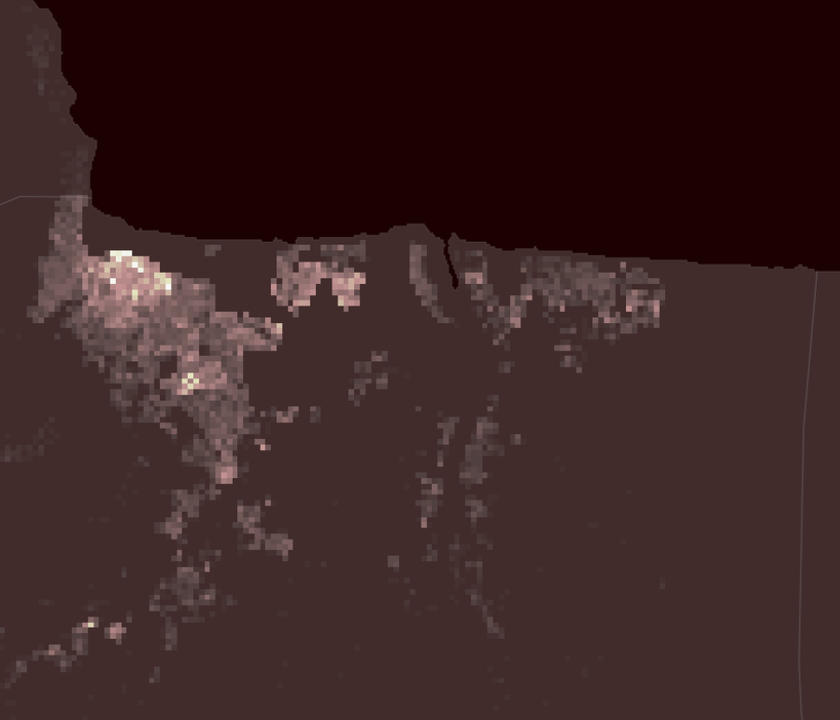

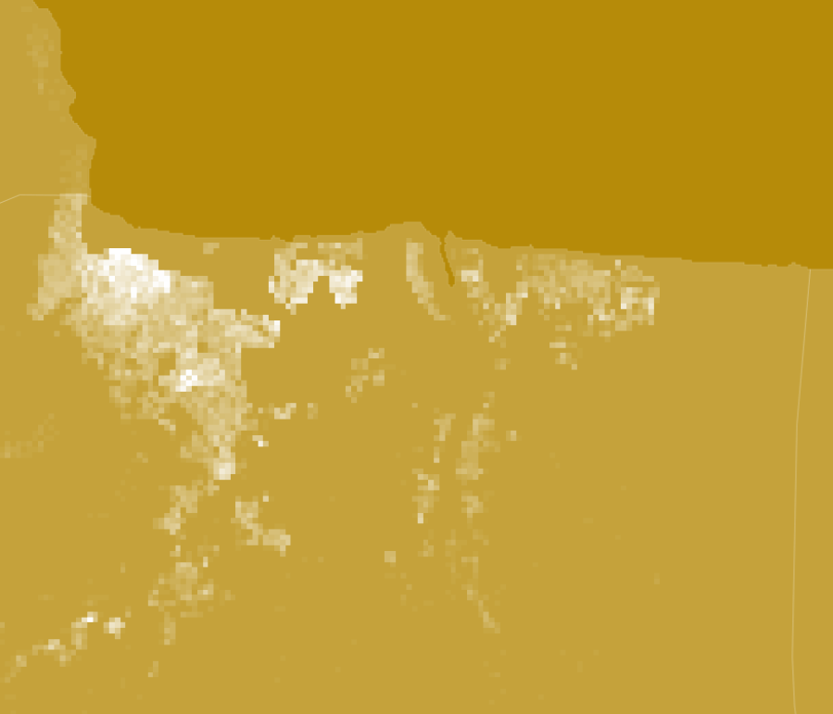
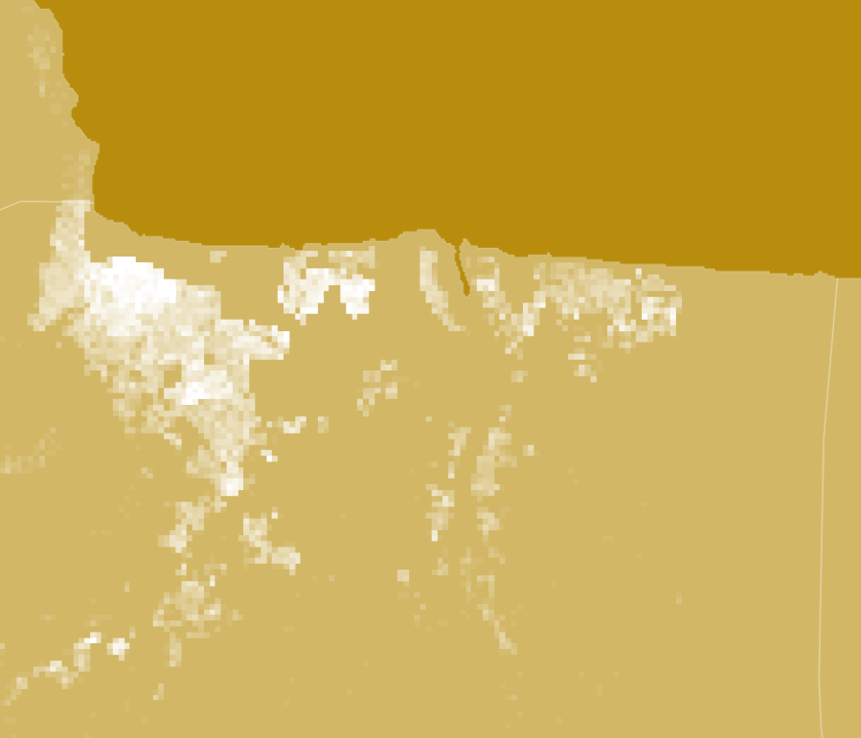
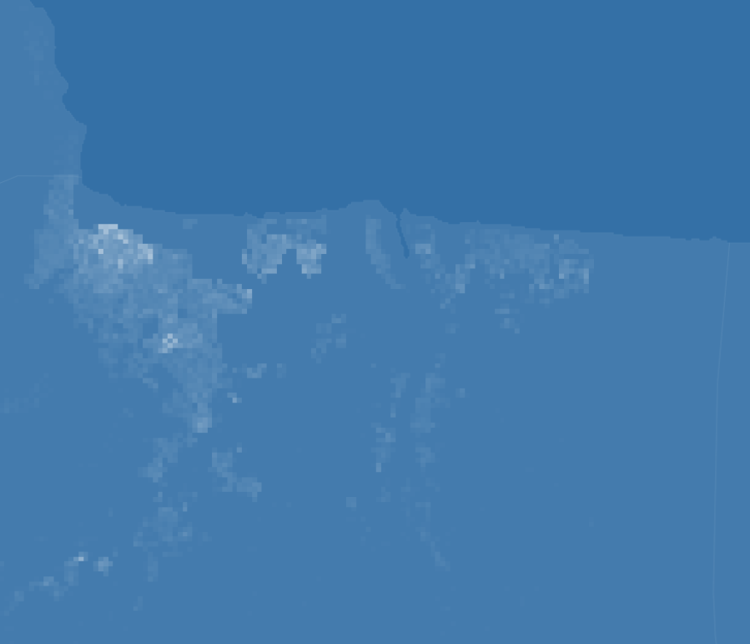
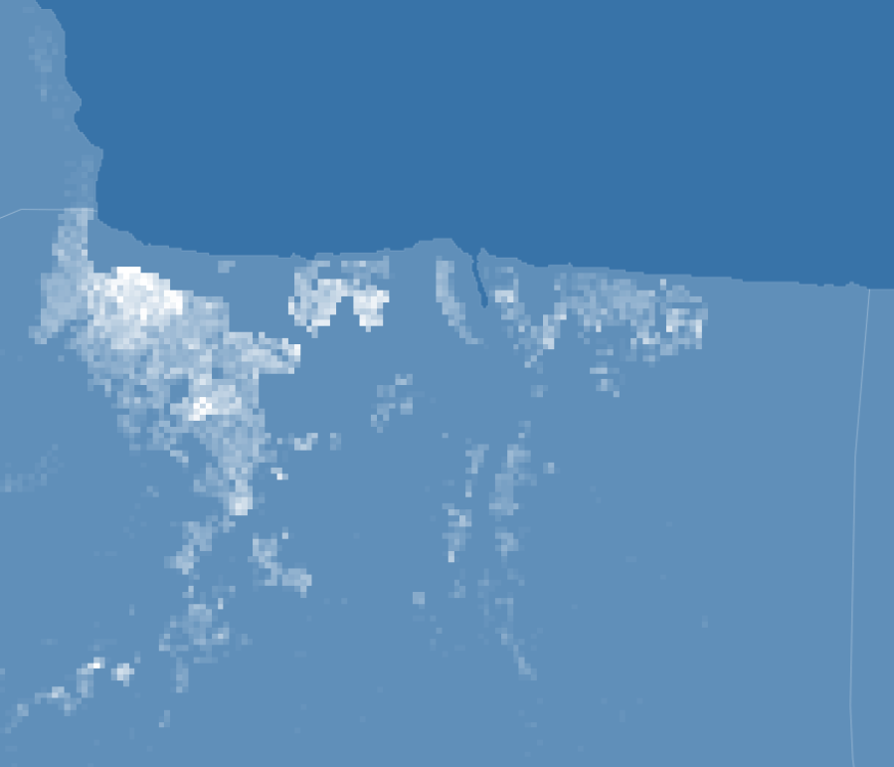
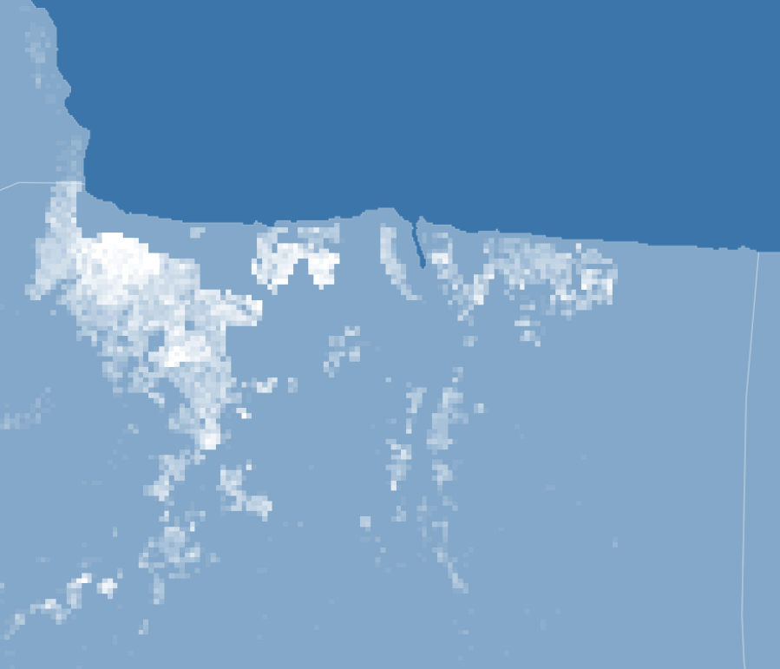
Near-real-time Grid CO2 Emission = f(Total Emission, Spatial Modifier, Temporal Modifier)
Spatial Modifier
The base emission for the grid
Total near-real-time
CO2 Emission
Near-real-time Grid CO2 Emission
f(building, household, population, land use type, heating/cooking source, …)
Temporal Modifier
The emission varied with time for the grid
Total regional emission from carbon monitor database
100*100 m
f(electricity, nightlight, surface temperature, air temperature, …)

Slide 4
Near-real-time Grid CO2 Emission in City’s Residential Area
f(Total Emission,
Spatial Modifier,
Temporal Modifier)
Spatial Modifier
Emission estimator
Economic indicator
Buildings
Population, Households
GDP, energy source,
Cooking/heating source, …
Area, Height, Type
ML model based on Open street map Buildings (OSMB) and other land use/cover datasets
Microsoft database (unlabeled)
Land use/cover
Total near-real-time CO2 emission
(from carbon monitor database)
Building Prediction
LCZ, human settlement layer, google landcover, …
Spatial res:
100*100 m or 500*500 m
Temporal res:
Daily or weekly
Output
Temporal Modifier
Energy consumption
Climate
Electricity,
VIIRS nightlights, …
Air temperature,
Land surface temperature, …

Slide 5
Datasets
Resolution Level | data | source
Country level | heating/cooking source | Census data or governmental statistical data
 | energy structure
 | GDP
 | Other economic indicator
City/division level | Population
 | household number
 | household size
Polygon level | Building number | ML model output trained with MS building dataset (https://github.com/microsoft/USBuildingFootprints), OSMB dataset (https://osmbuildings.org/), and other grid-based dataset, such as LCZ, Copernicus DEM, night light, …
 | Building area, type, level
Grid level a: already used in our dataset b: will be used (in processing) c: important, considering to use d: might be used | a: LCZ (100*100m) | https://zenodo.org/record/6364594#.YsgpS3ZBybg
 | a: EU, VIIRS nightlights | https://eogdata.mines.edu/products/vnl/
 | b: Google, Land surface temperature | https://developers.google.com/earth-engine/datasets/tags/surface-temperature
 | b: EU, Human settlement layer | https://ghsl.jrc.ec.europa.eu
 | c: Copernicus, DEM | https://spacedata.copernicus.eu/web/cscda/dataset-details?articleId=394198
 | c: ERA5, Air temperature | https://www.ecmwf.int/en/forecasts/datasets/reanalysis-datasets/era5
 | c: Poverty | https://partage.lsce.ipsl.fr/service/home/~/?auth=co&loc=en_US&id=7160&part=2.2
 | d: Google, land cover | https://blog.google/products/earth/dynamic-world-land-cover-data/
Note: the datasets are not limited in those are listed, and we will replace some of those datasets if we find some alternative dataset with higher quality.

Slide 6
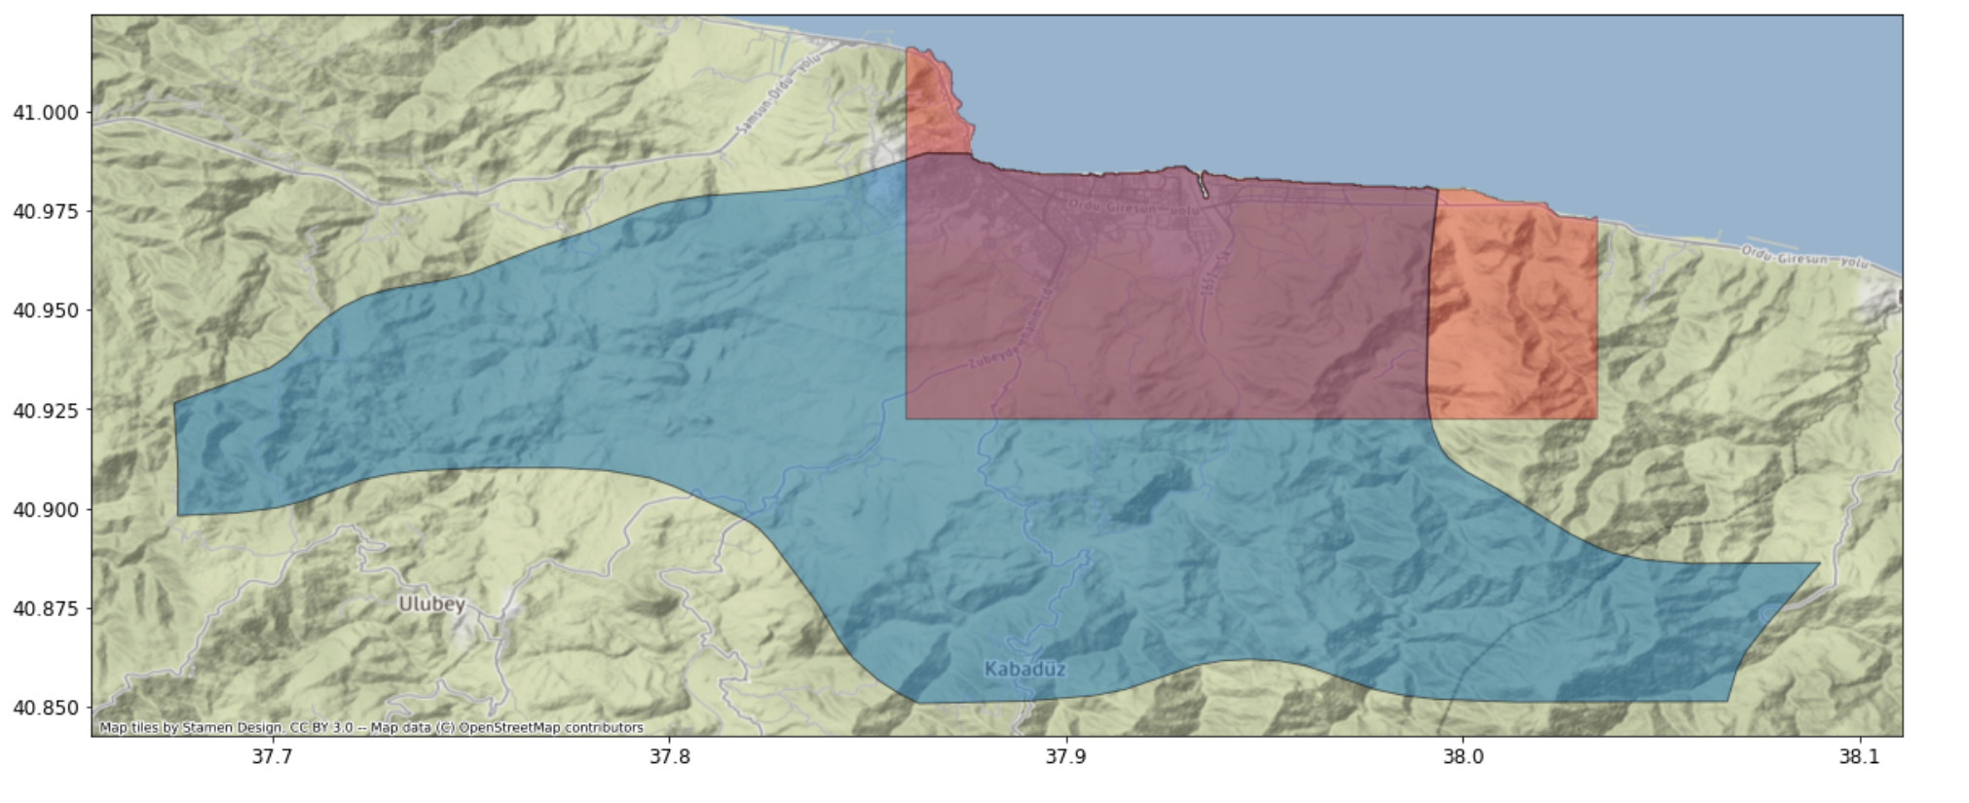
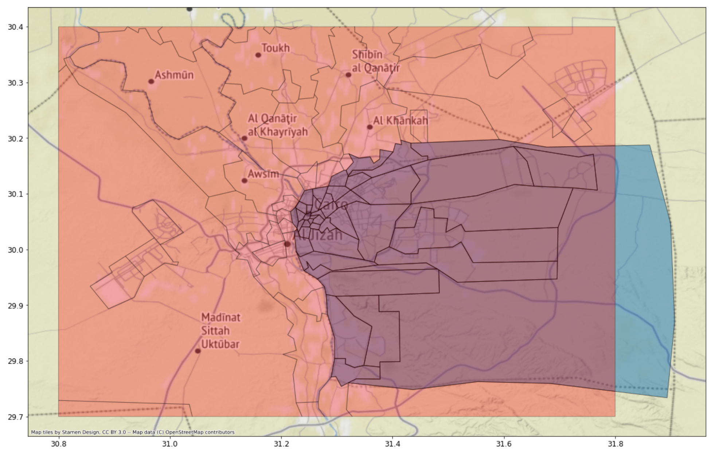
Region defines
Regions need to be defined with boxes
Administrative divisions include large non-urban areas (not of our interests)
Continuous urban areas are divide into parts by administrative division
Uncertainties
We assume the selected regions has the same administrative region data, such as population, household number, …

Slide 7
How we select the region
The most populated region (urban area) for the proposed cities will be included.
The closely adjacent populated regions will also be included until the we see a clear break of the urban area, or the region become too large.
We adjust the region based on the MS buildings and LCZ maps (world urban database, https://www.wudapt.org/lcz-maps/)
Most of the dense building areas (both MS buildings and LCZ categories) are included in our regions

Slide 8
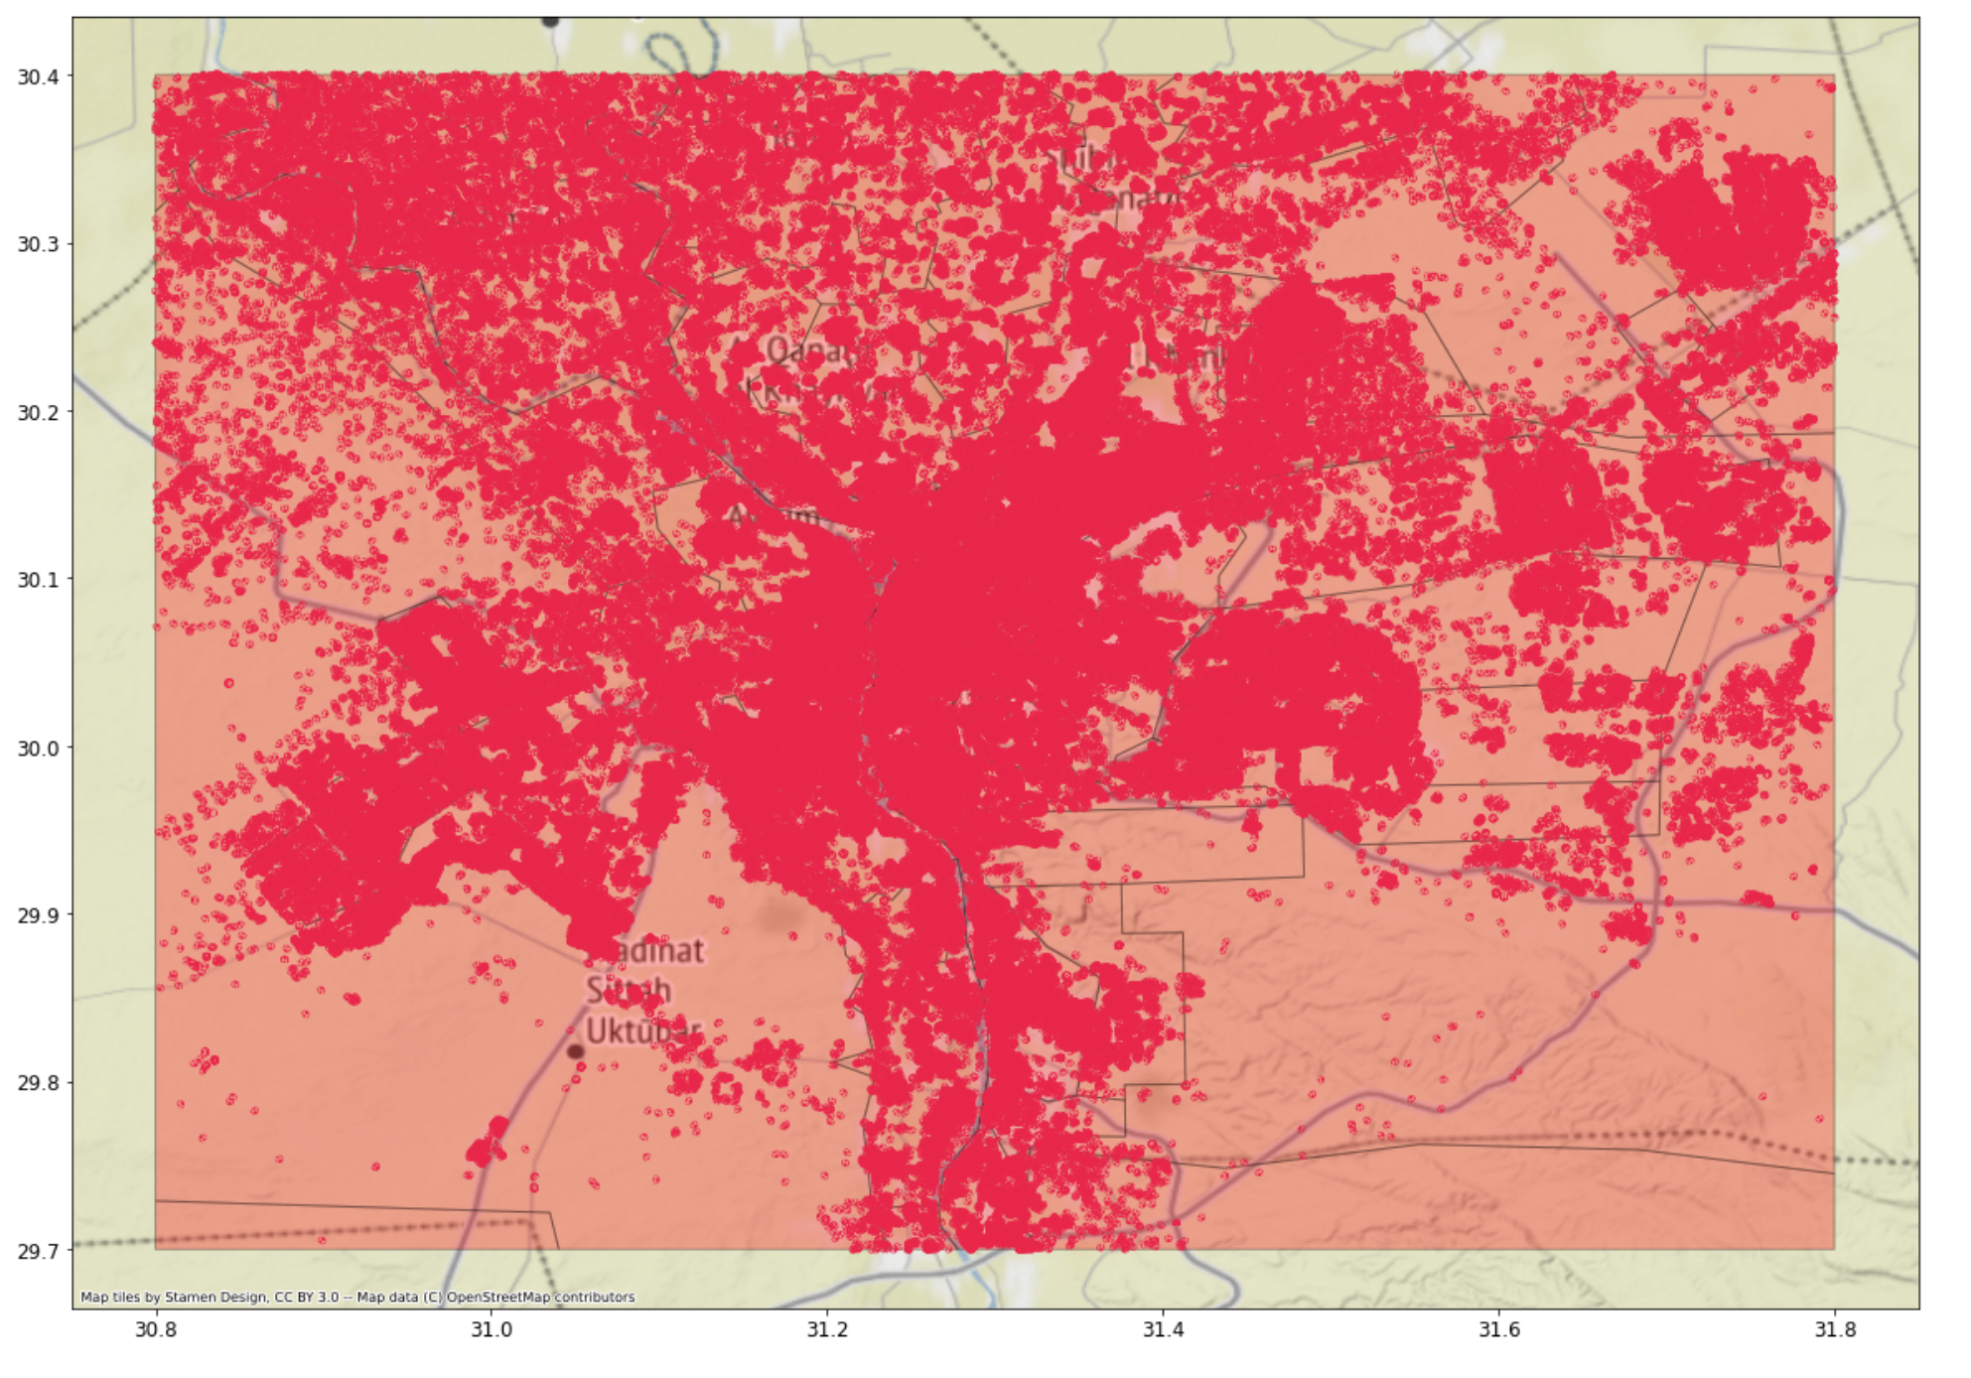
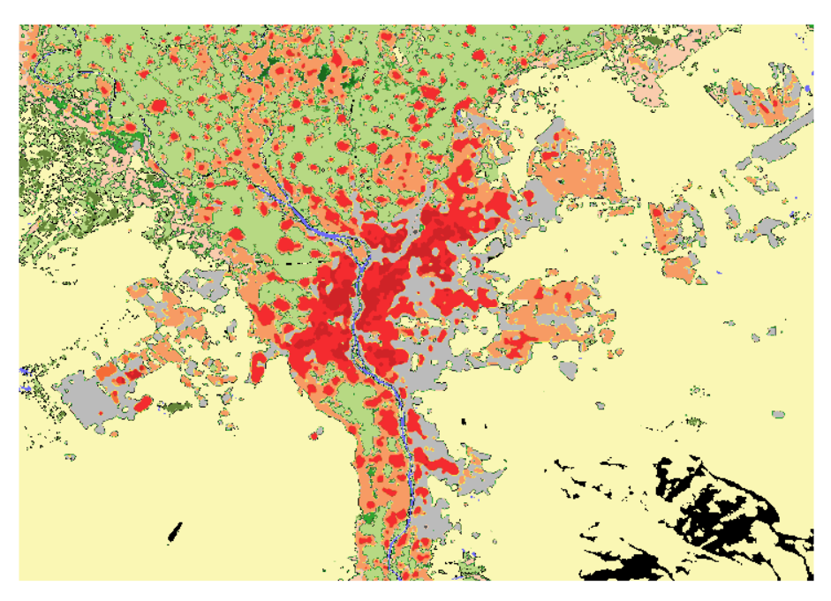
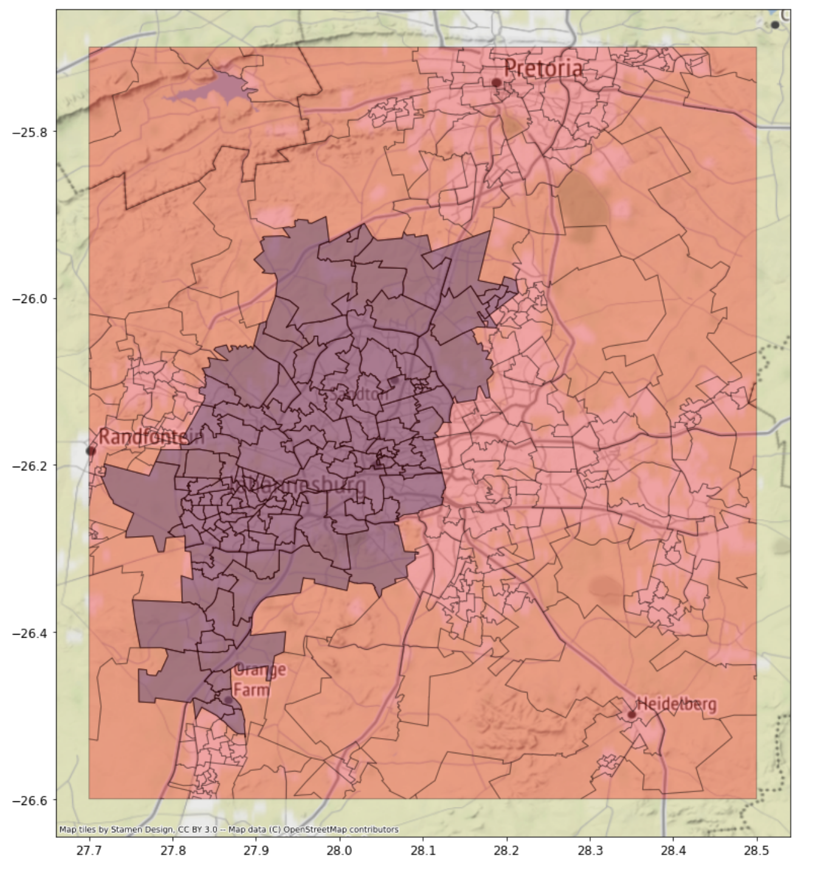
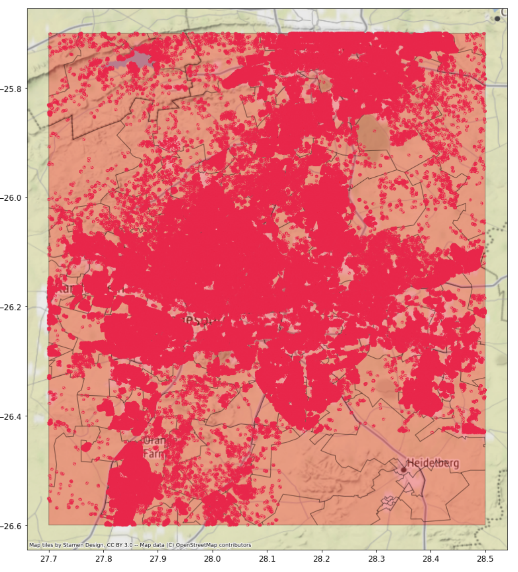
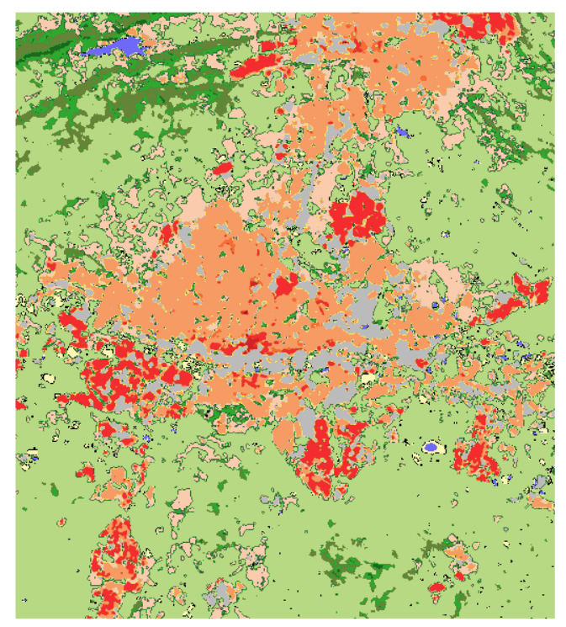
Cairo
Top left: (30.4, 30.8),
Bottom right:(29.7, 31.8)
Microsoft building
Johannesburg
Top left:(-25.7, 27.7),
Bottom right:( -26.6, 28.5)

Slide 9
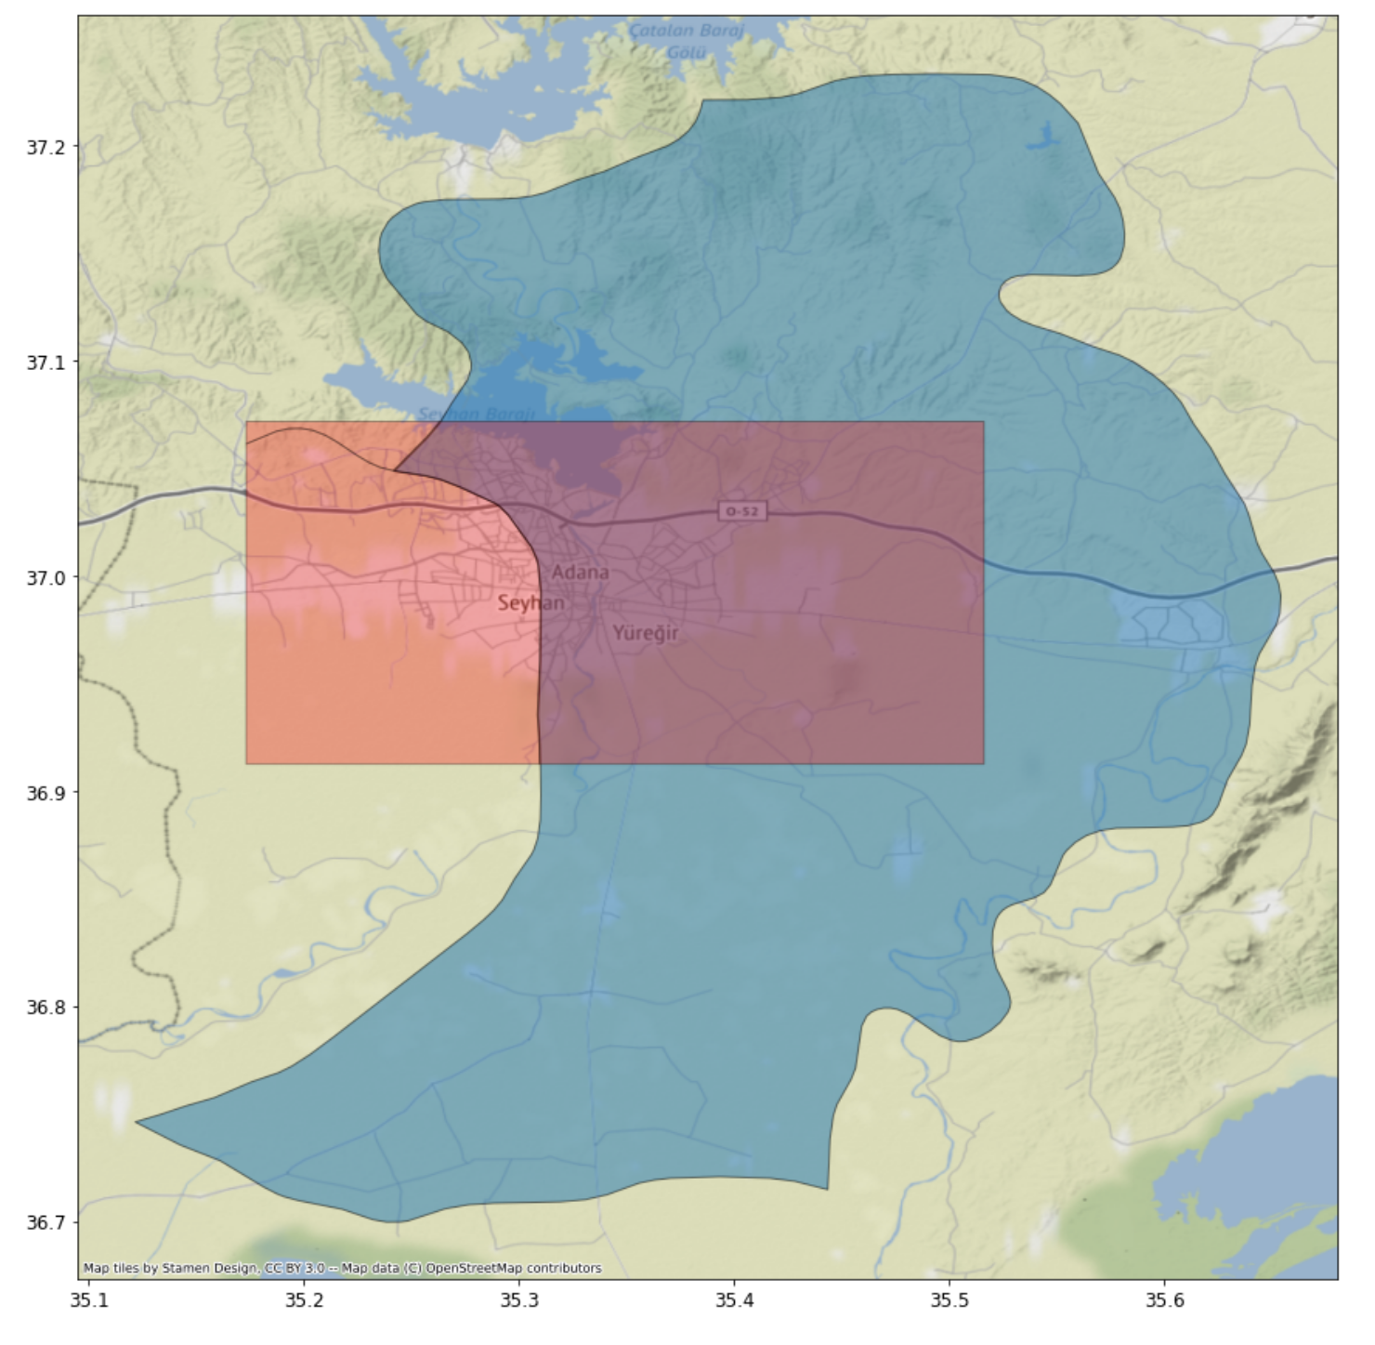
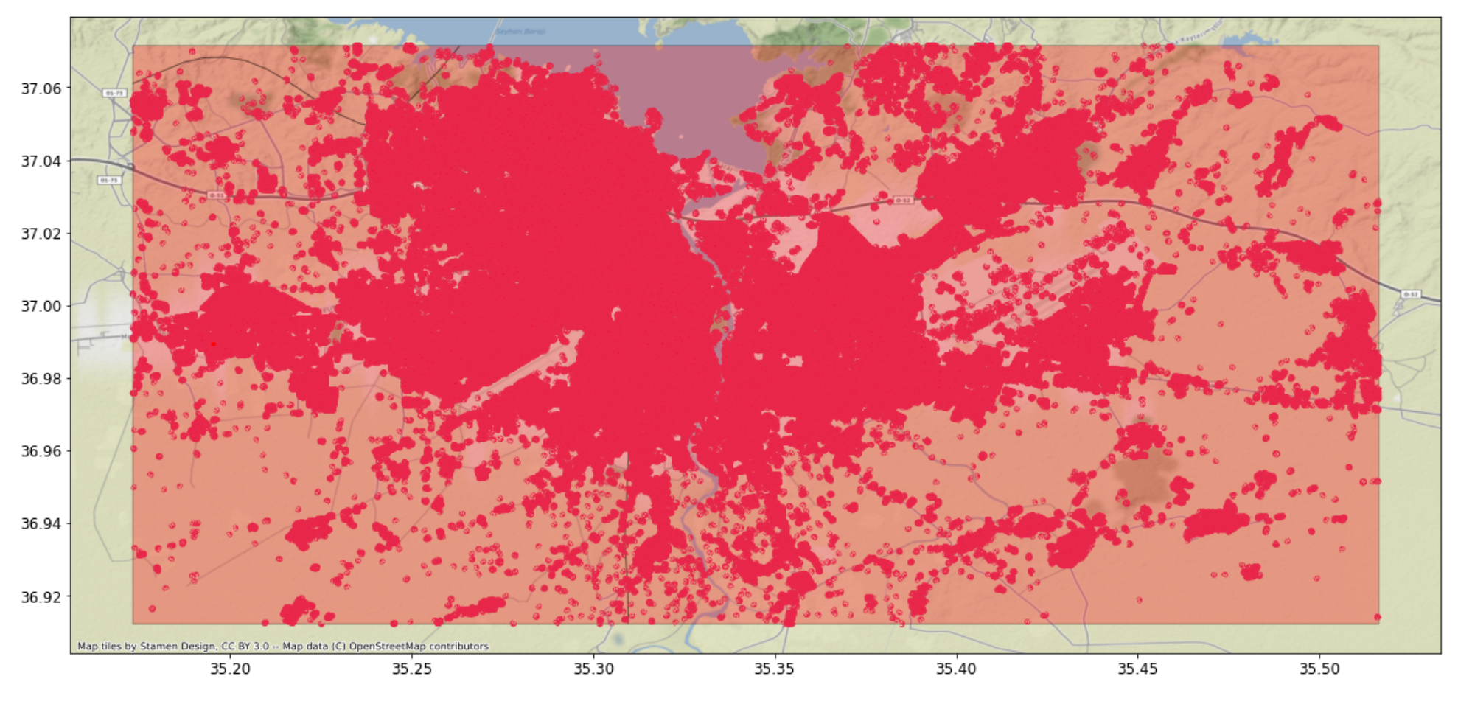
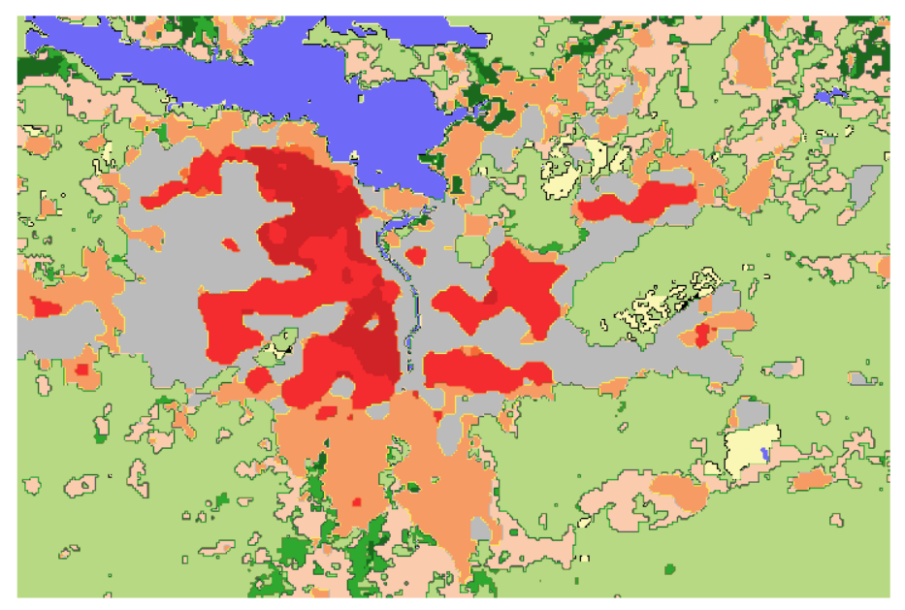
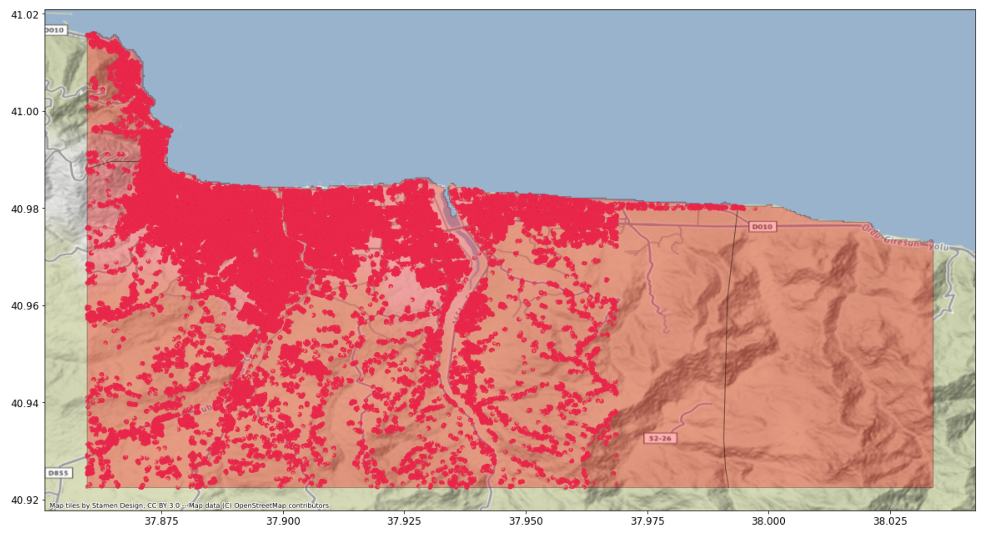
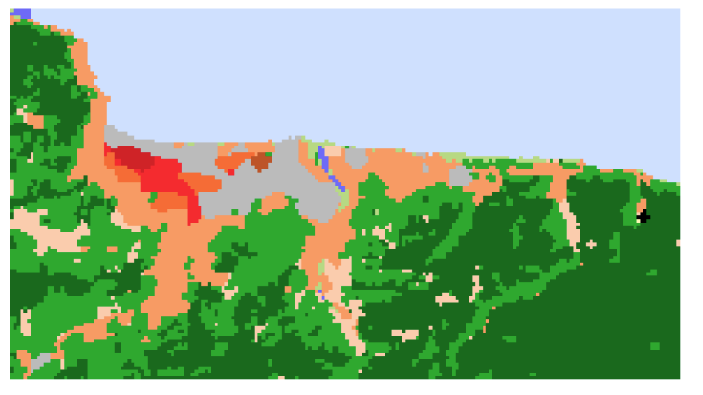
Adana
Top left:(37.1, 35.2),
Bottom right:(36.9, 35.5)
Ordu
Top left:(41.02, 37.85),
Bottom right:( 40.92, 38.03)

Slide 10
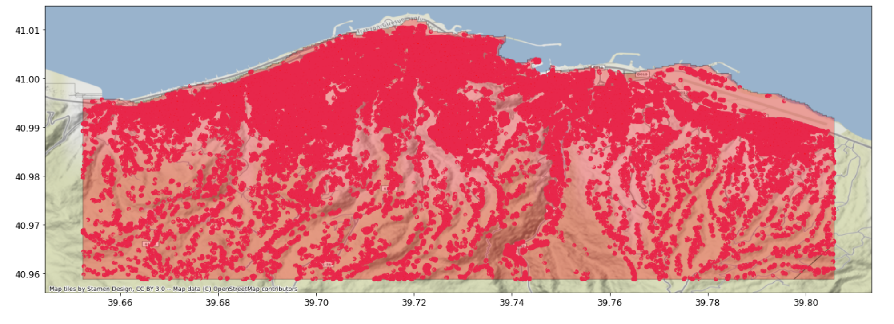
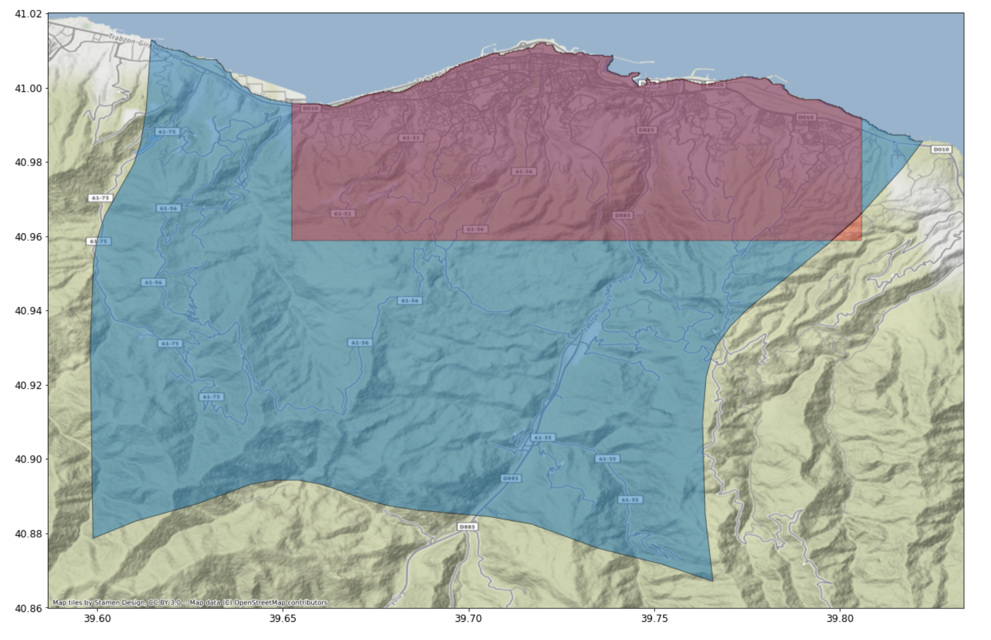
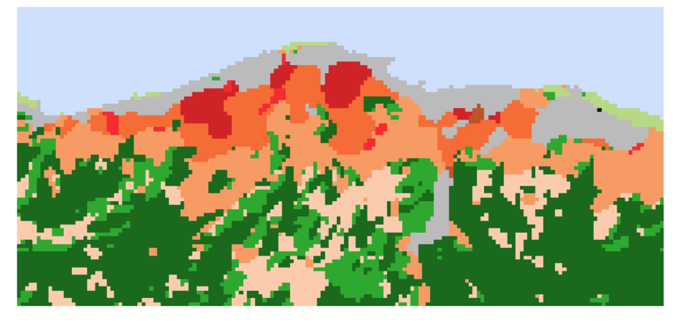
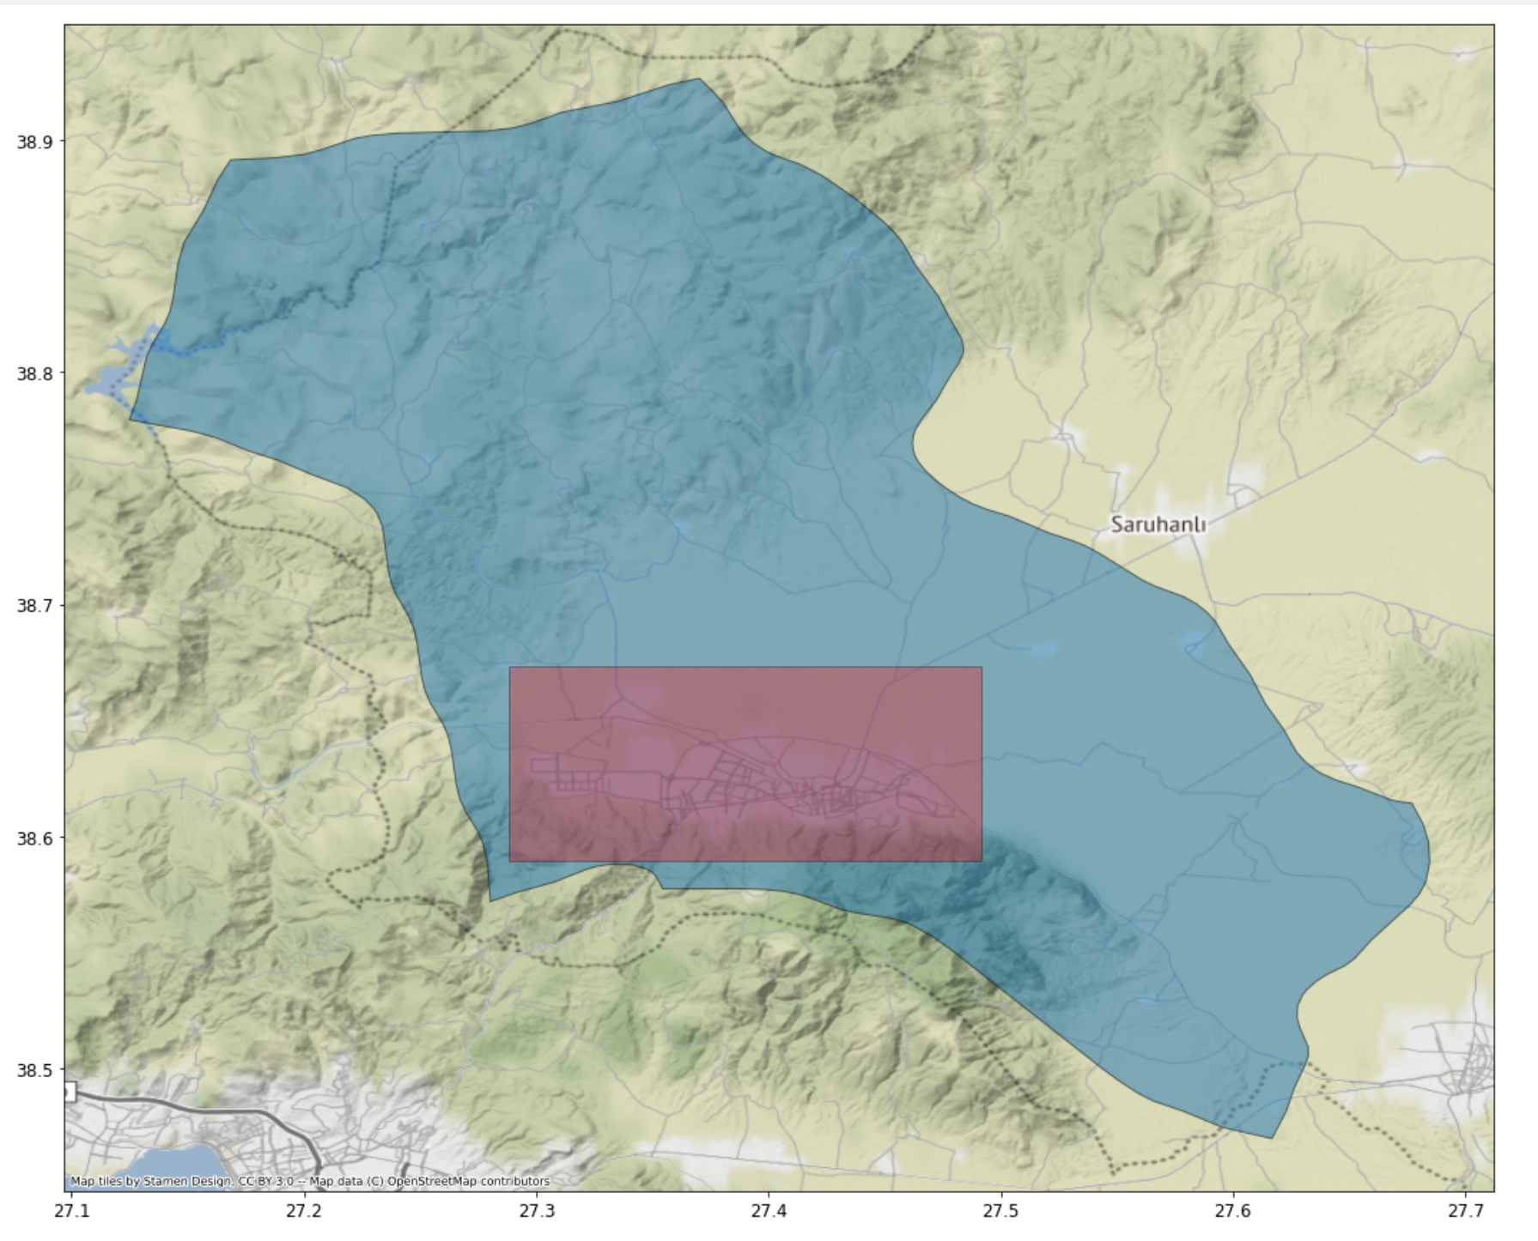
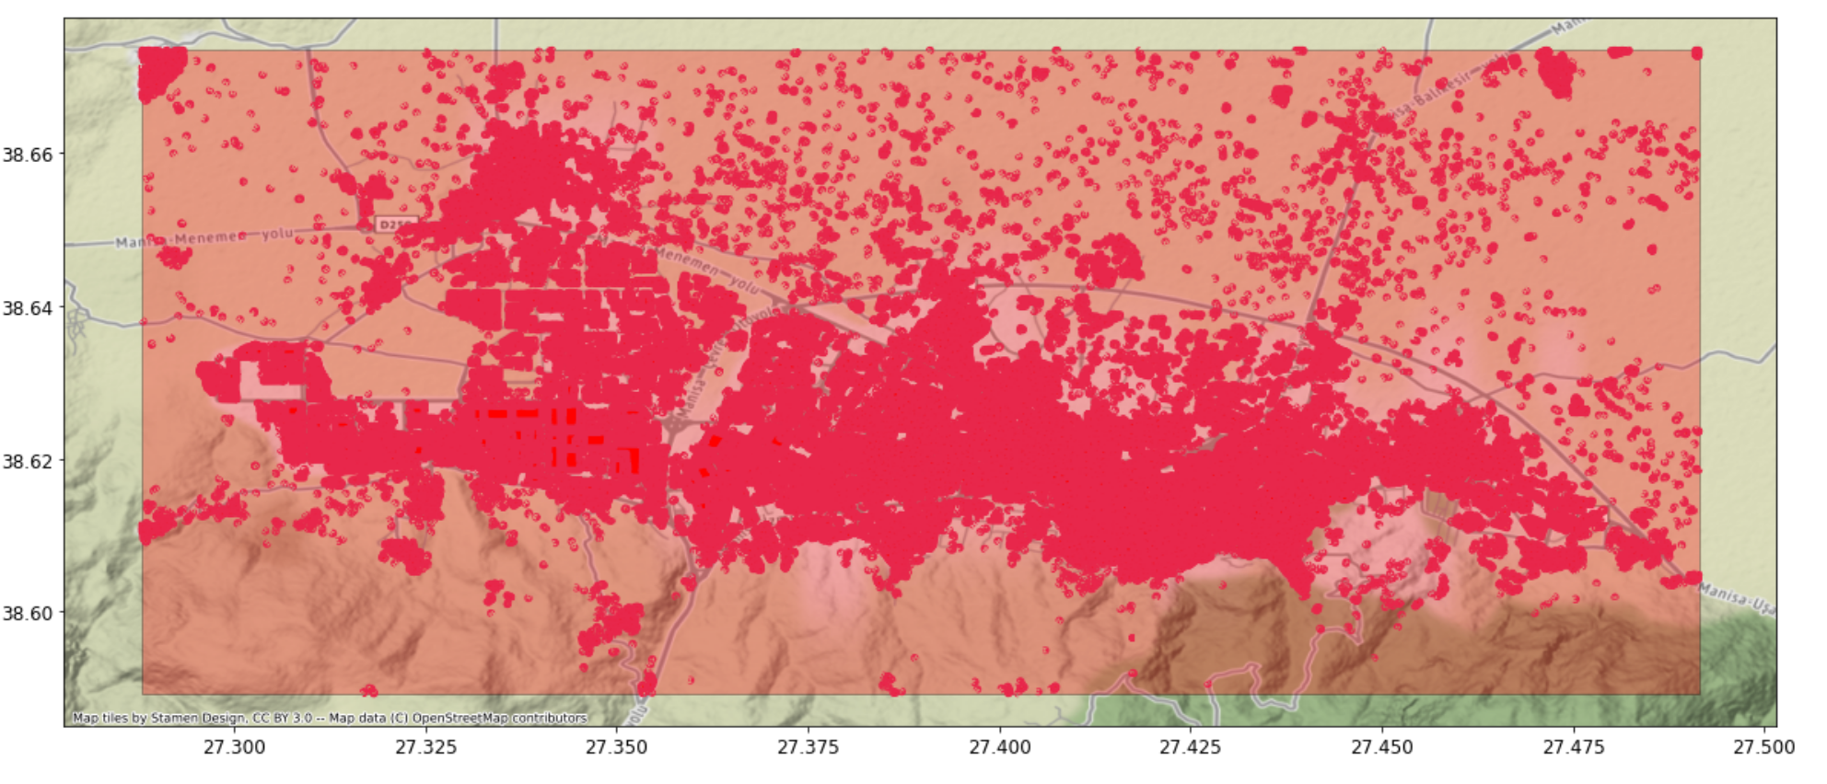
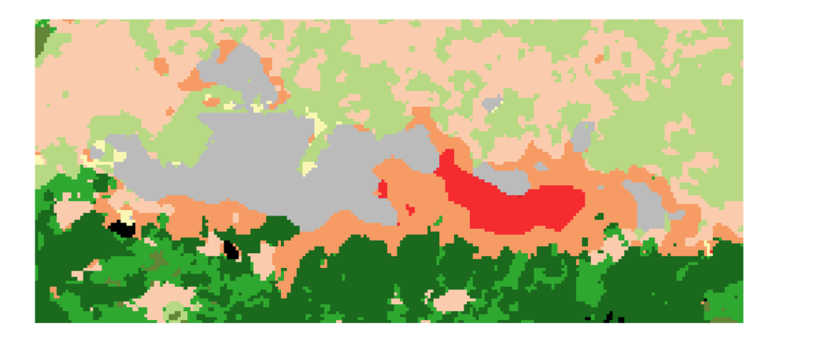
Top left:(41.02, 39.65),
Bottom right:( 40.95, 39.80)
Trabzon
Manisa
Top left:(38.67, 27.28),
Bottom right:(38.58, 27.49)

Slide 11
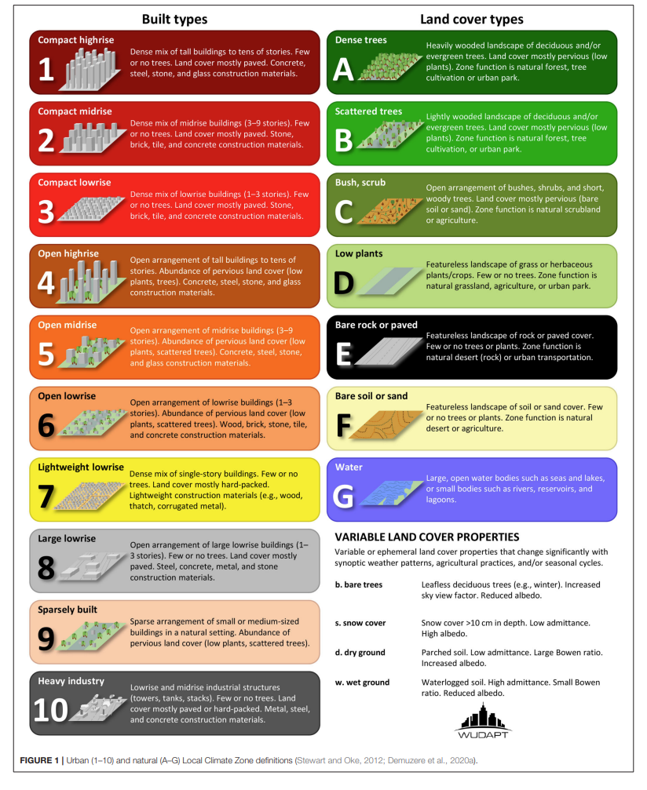

LCZ class and color scheme
Water
Sand
Rock
Low plants
Bush
Scatter trees
Dense trees
Industrial
Buildings in nature land cover
Large 1-3 stories
Dense 1 story
1-3 stories
3-9 stories
Over 10 stories
Dense 1-3 stories
Dense 3-9 stories
Dense over 10 stories

Slide 12
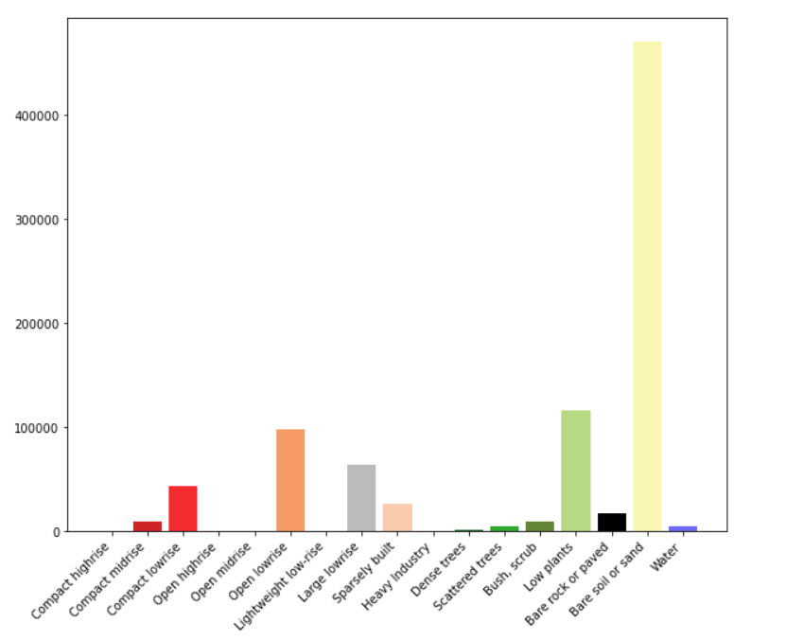
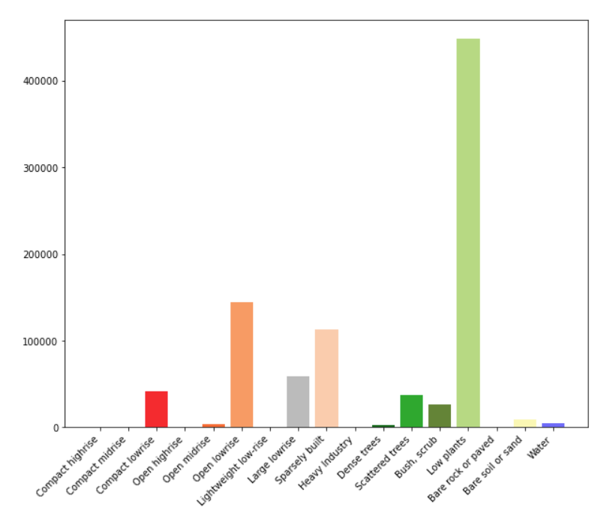
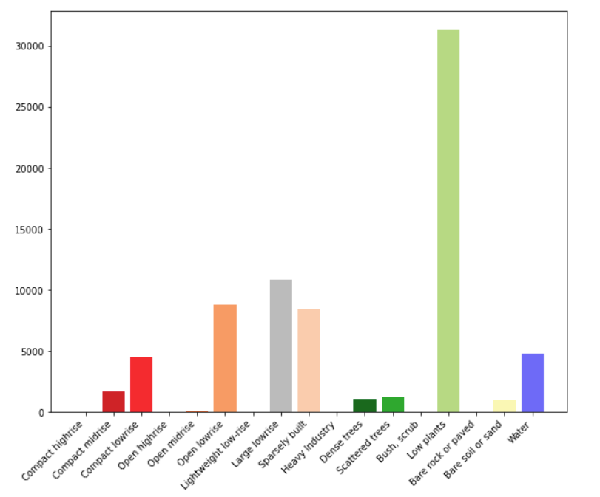
Cairo
Johannesburg
Adana

Slide 13
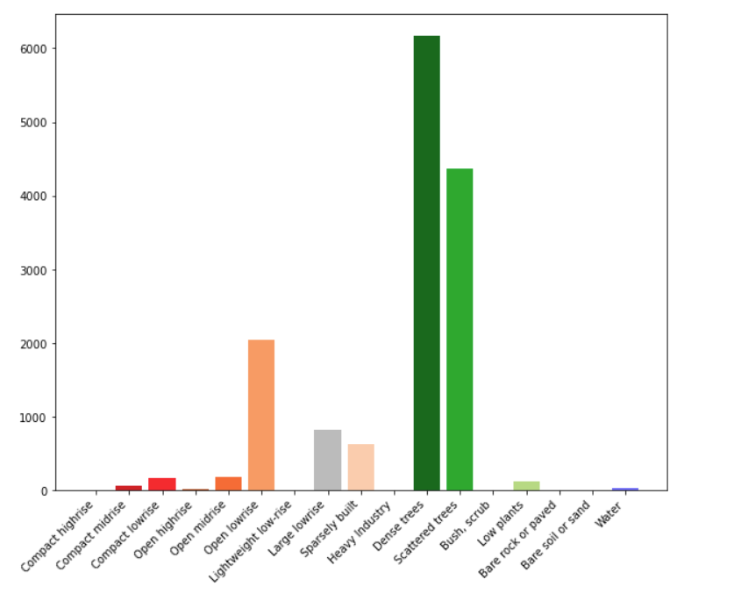
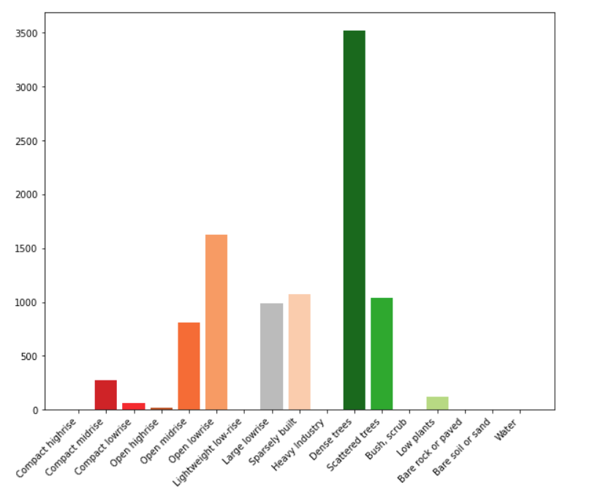
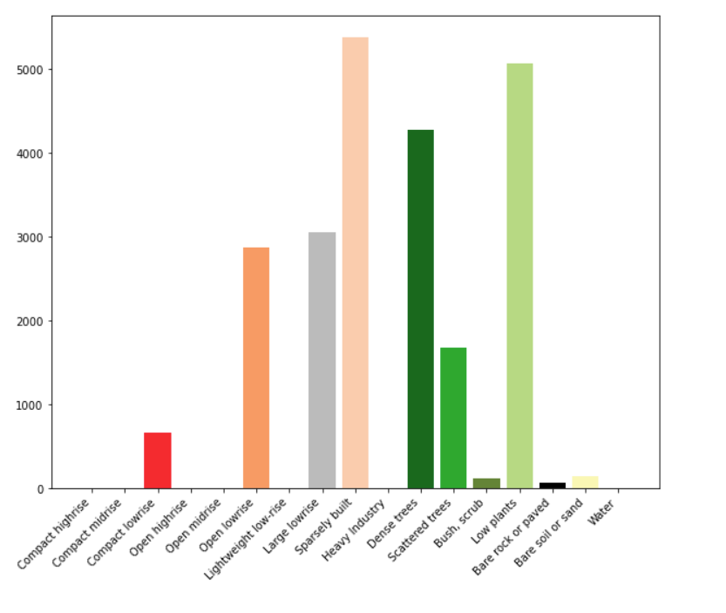
Ordu
Trabzon
Manisa

Slide 14
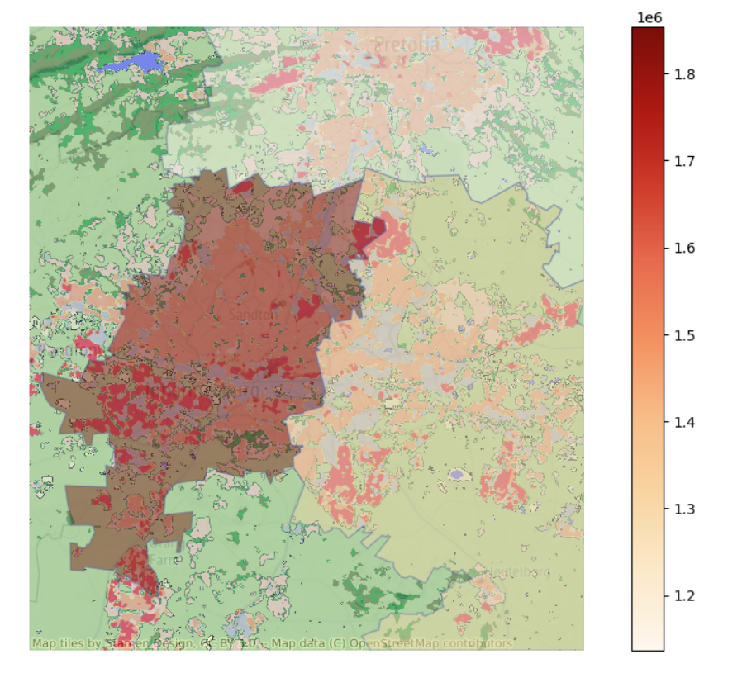
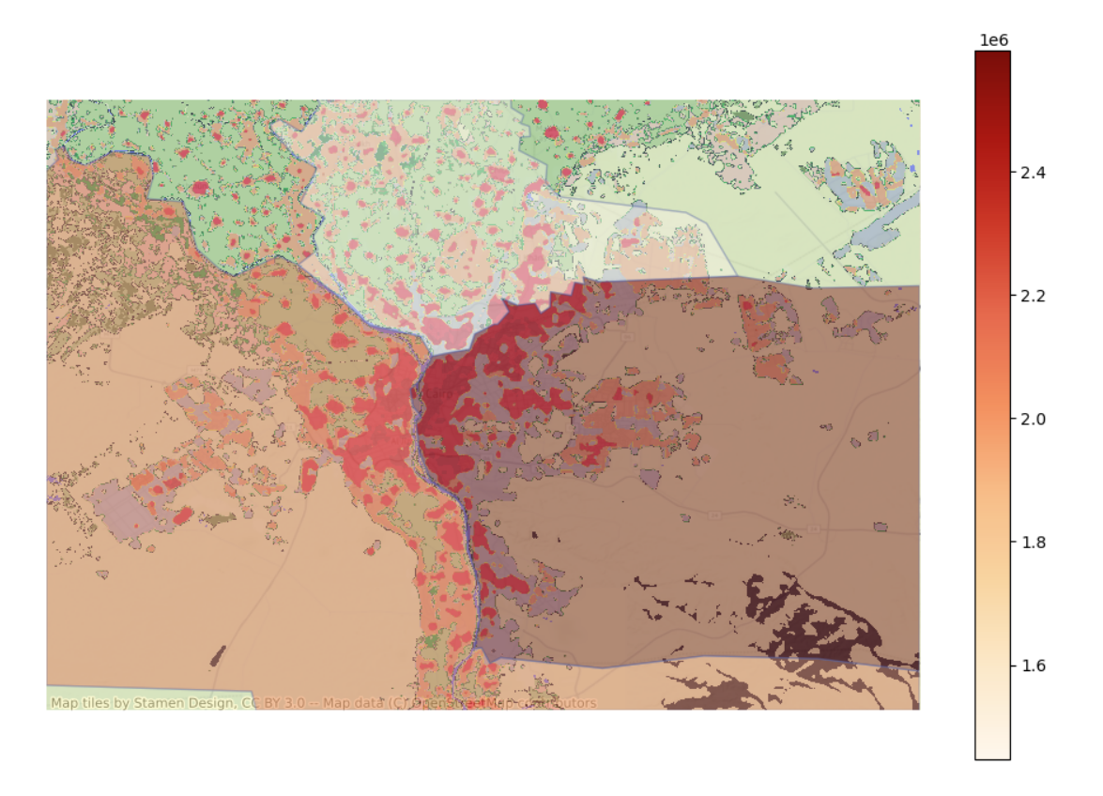
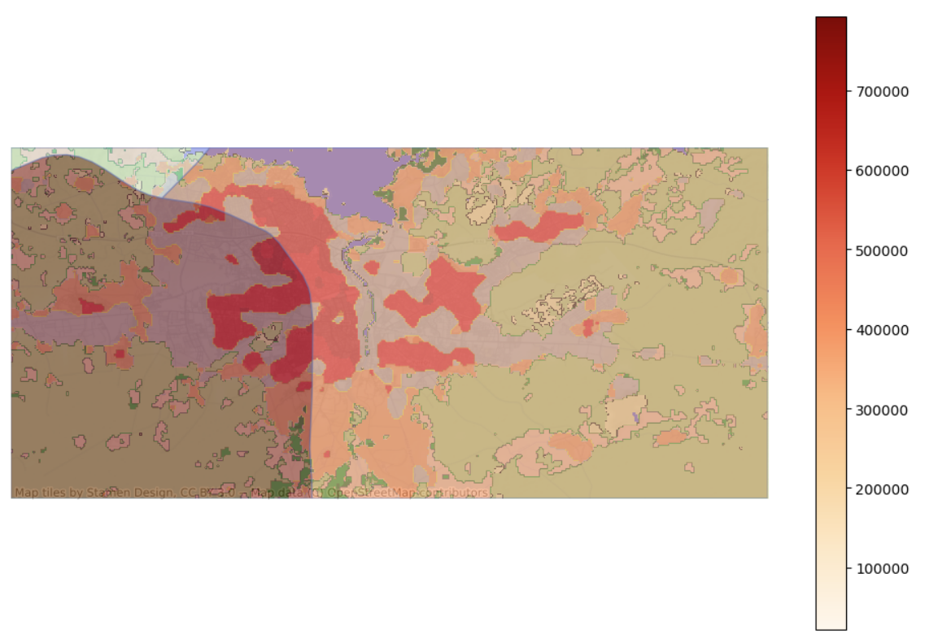
V0: polygon based
Johannesburg
Cairo
Adana

Slide 15
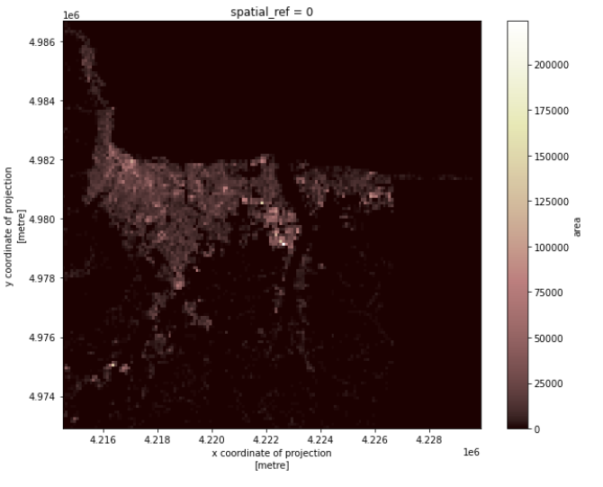
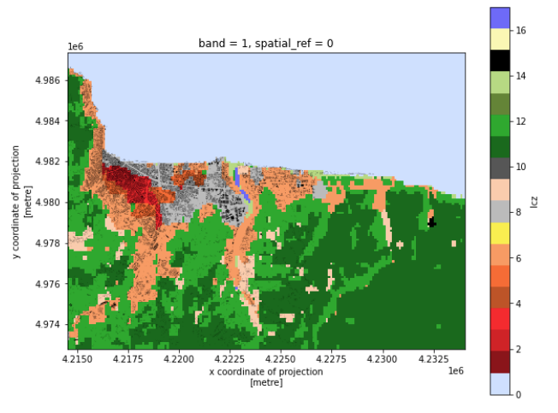
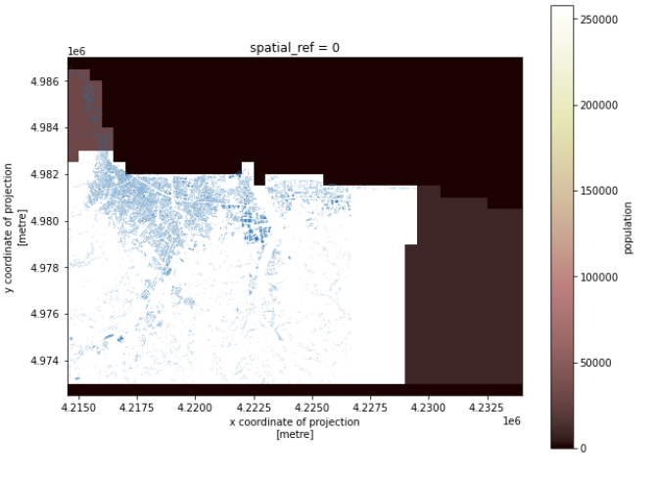
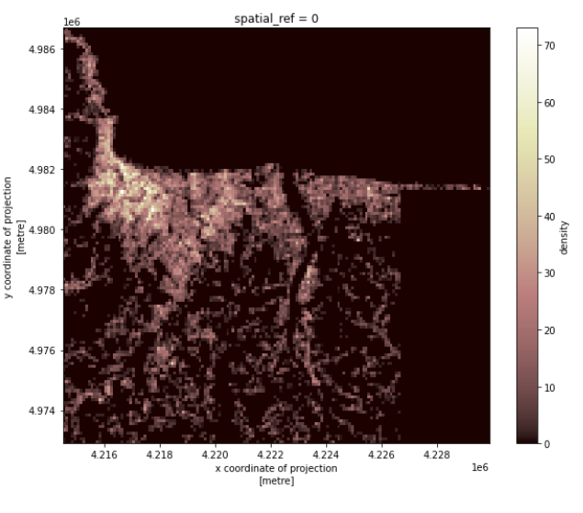
V1: gridded map with no time variance
Add polygon layers, such as administrative division, buildings, …
Add raster layers, such as LCZ, night light, …
Bind data to polygons layers, such as population, area, …
Rasterize the polygon layers (polygon -> raster)
Unify the resolution for all the raster layers
Calculate emission raster
Make output dataset and visualization
Rasterize
Polygon layers
Polygon + raster layers
Building area
Building density

Slide 16
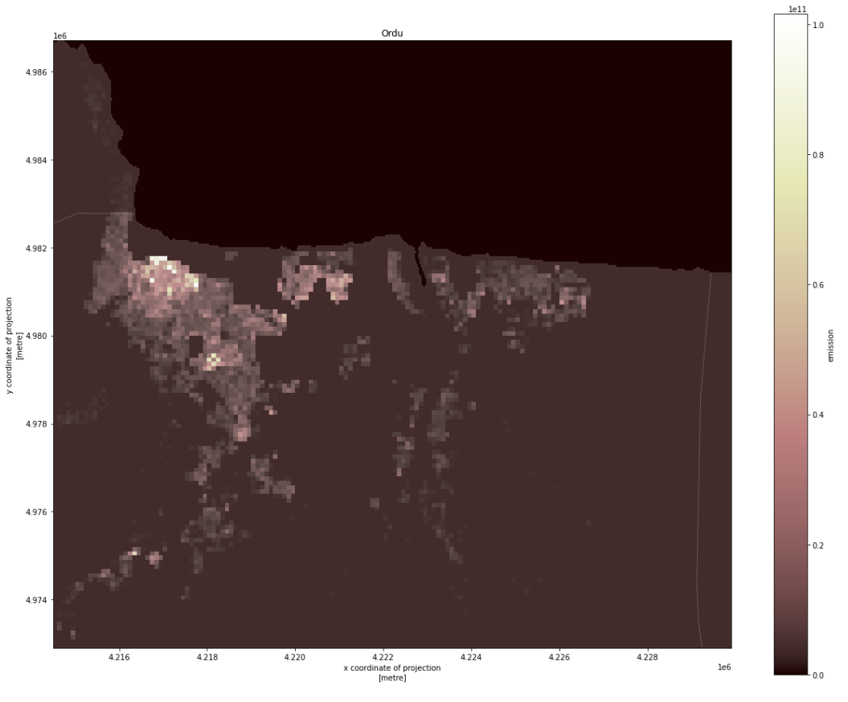
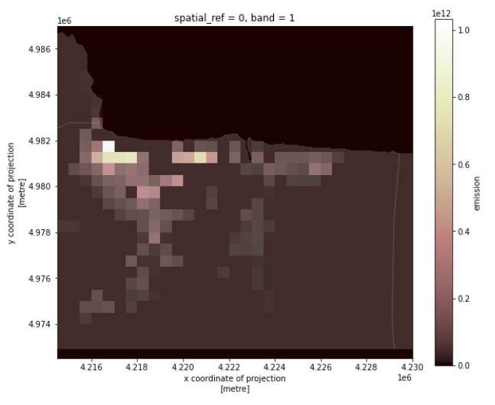
100*100 m
500*500 m
Simple emission = (density + area*lcz_height)* population

Slide 17
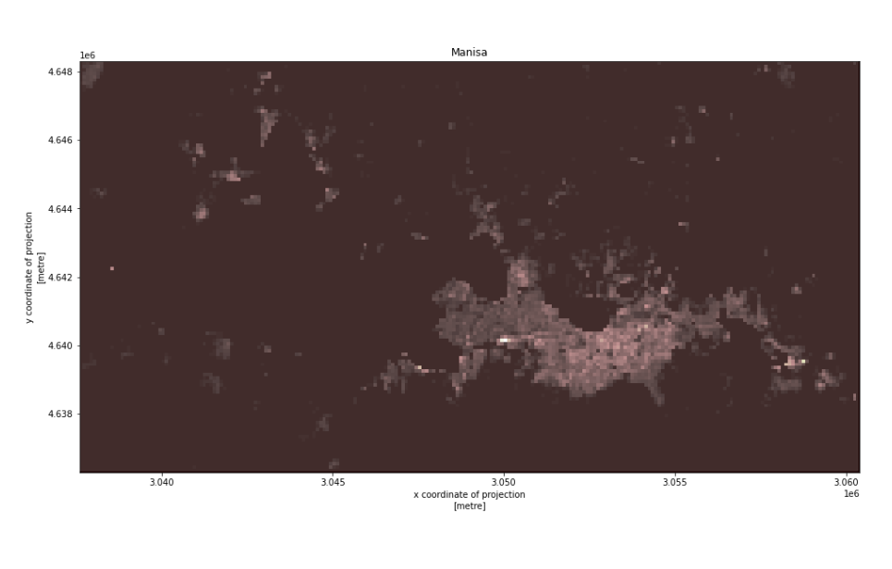
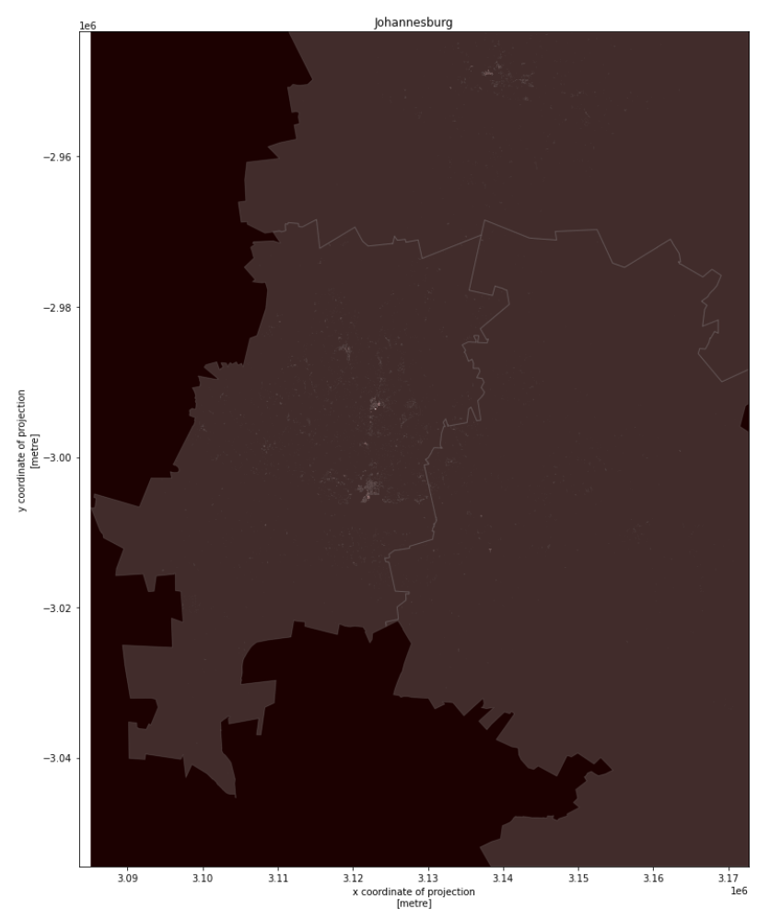
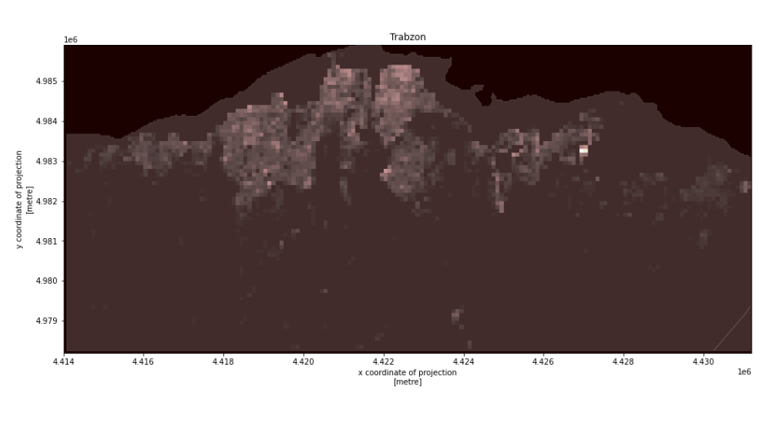
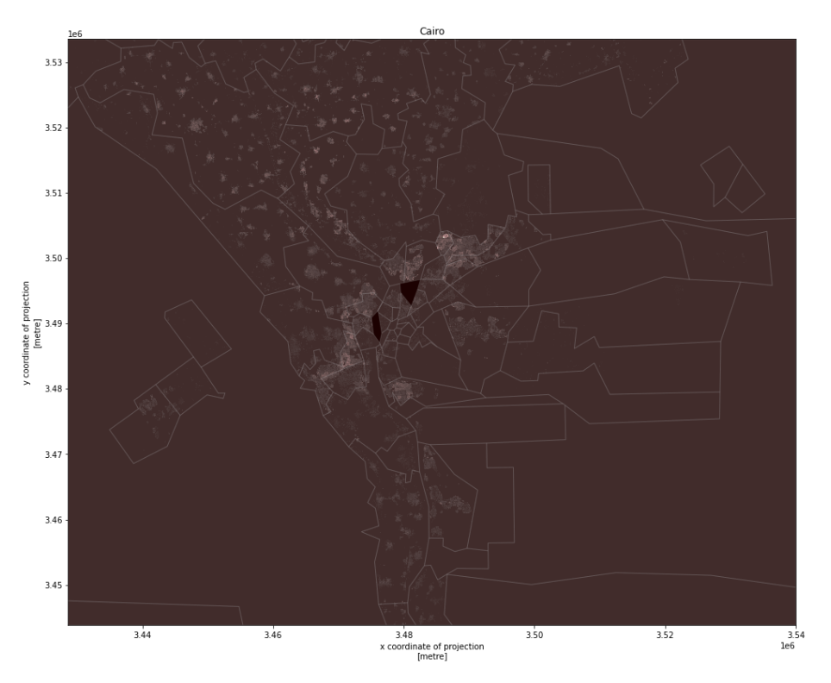
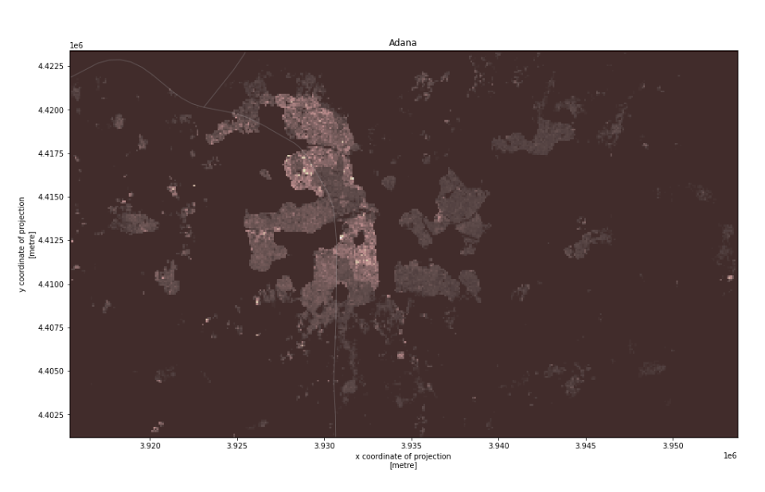

Slide 18
Johannesburg
Adana
Trabzon
Manisa
Ordu
Cairo
Simple emission
= (density + area*lcz_height)* population
The figures show the estimated emission weights for each grid, not final emissions.
The light spots in small cities does not indicate a higher emission.
The lighter grids indicate larger emission weights.

Slide 19
Building Floor/Type Estimator
Microsoft database
(Polygenes only)
1. Compare the polygenes
If the polygenes from the two database can be matched, we can train a model with OSMB and predict on Microsoft database
2. Find out some other dataset that can be used as Feature
3. Build prediction model
X: Polygene, Landcover, radar, ladar, light,…
Y: Height, type
Training/testing: Open street map Buildings
Predicting: Microsoft database
Type1: Non-deep learning
We use each polygene as data sample
Type2: Deep learning
We use map tiles as data sample (we can random sample map tiles from target region as sample)
Open street map Buildings (OSMB)
(Polygene, height, type)
Landcover,
radar,
ladar,
Light, …
Activity Estimator
Total Emissions need to be assigned
Emission Multiplier
Naïve
f(pop, type)
CO2 Emission
Emission Factor
Population Density
f(area, floors, type)
Heating
Street Level
Satellite light image
f(pop, type, light)
Building Type
Electricity Usage
Miscellaneous
Map Grid
Based on other data source, TomTom, …
Activities

Slide 20
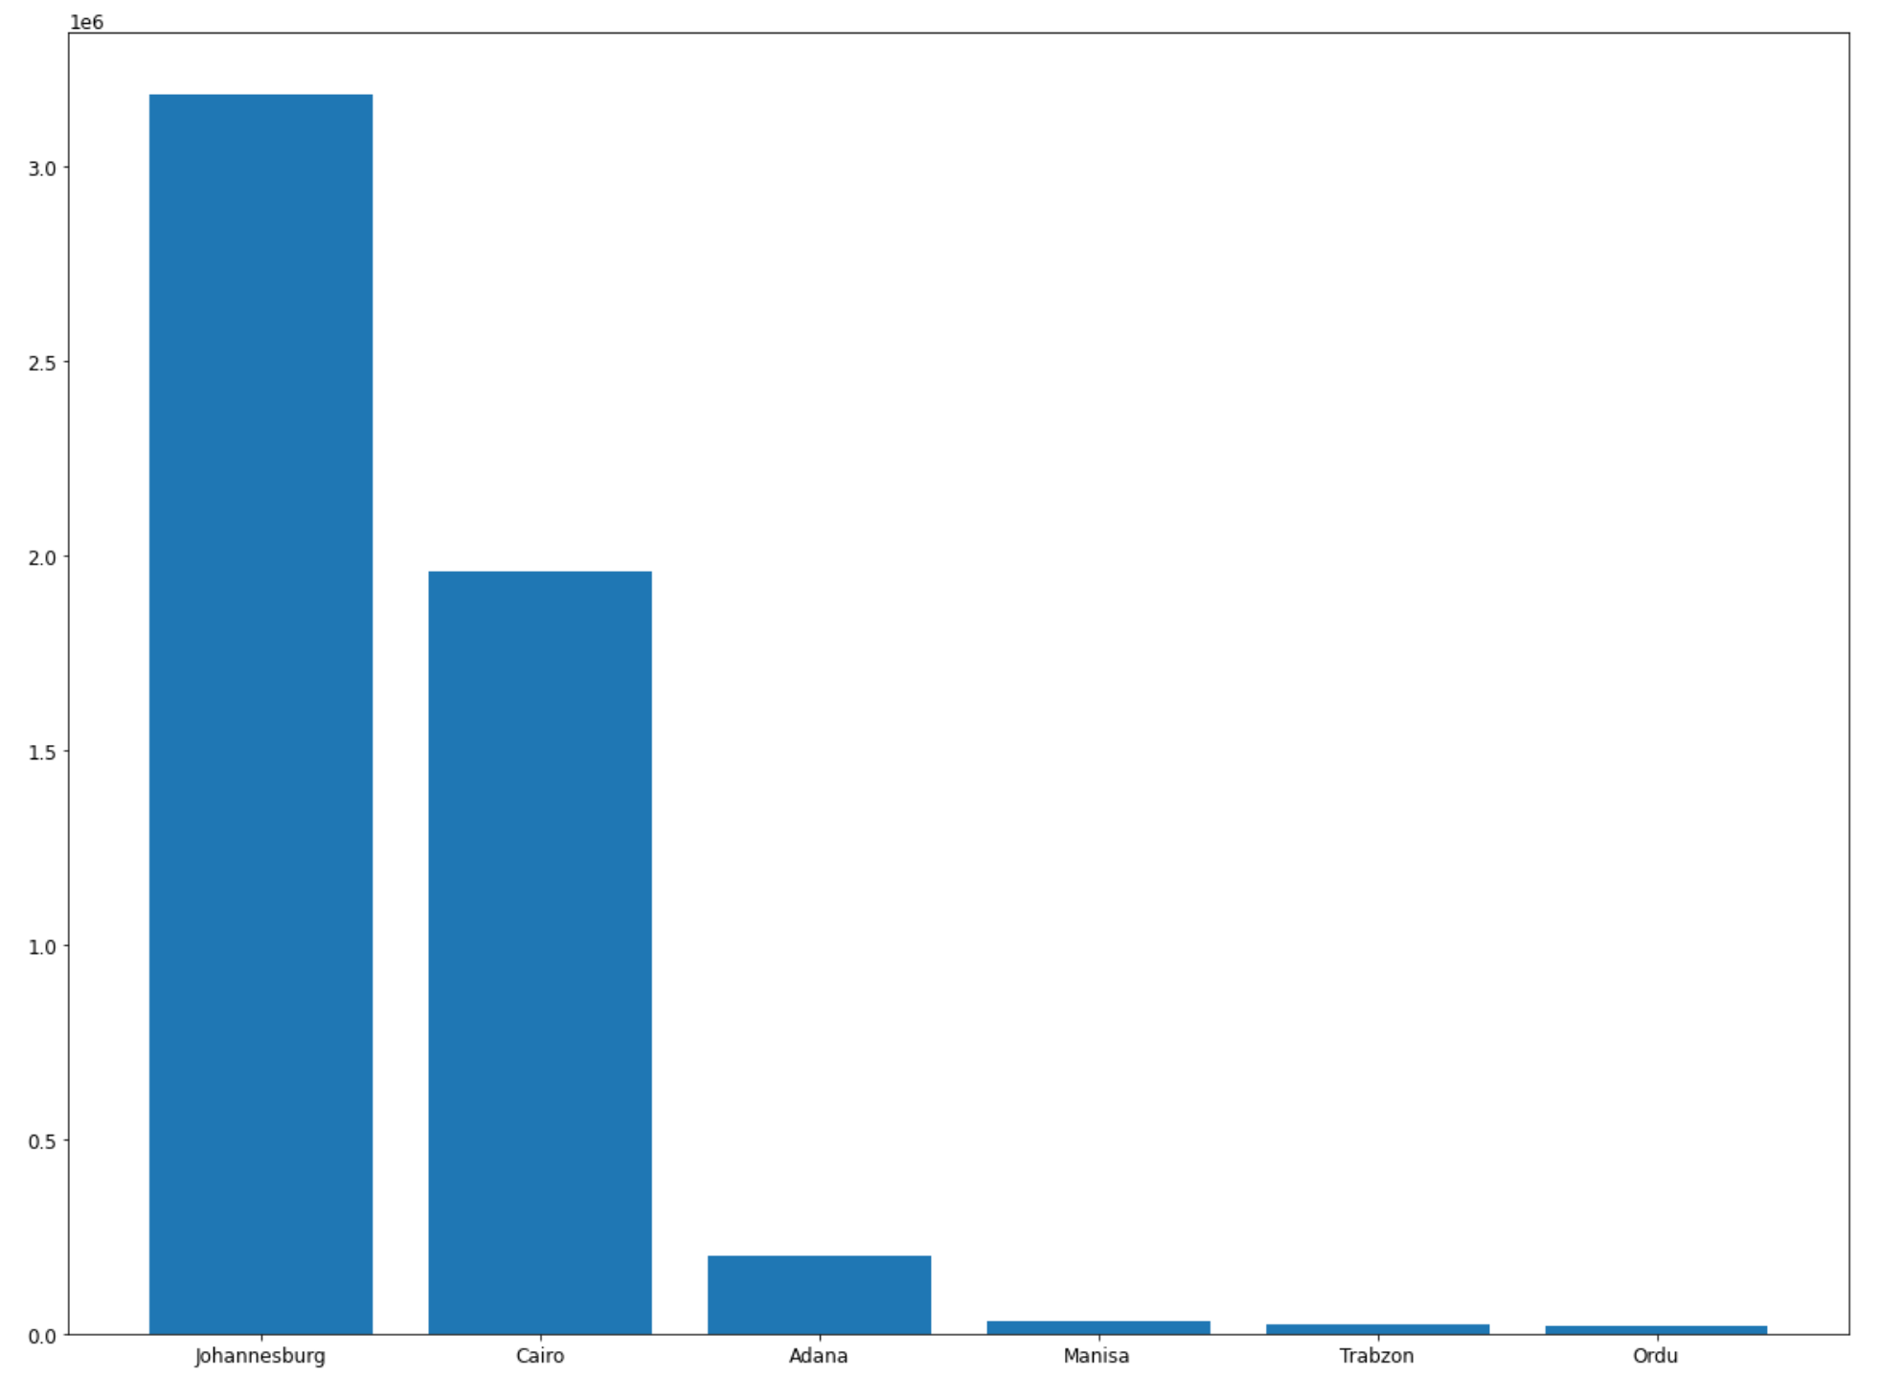
House numbers

Slide 21
V2 : Non Learnable, Spatial Modifier only
Changes brought :
1. Region boxes are now defined given the GHSL FUA dataset as suggested
https://ghsl.jrc.ec.europa.eu/ghs_fua.php
2. Population is taken from the GHSL Population dataset (already gridded,
consistent source)
3. Building Height is taken from the GHSL Built-H dataset (takes multiple inputs
that are therefore ignored here)
4. Estimator equation is changed accordingly. It becomes :
e = population * nightlight * building_density * building_volume
where building_volume = building_area * building_height

Slide 22
V2 : Non Learnable, Spatial Modifier only
Resolution Level | data | source
Polygon Level | Building number, area | MS Building dataset https://github.com/microsoft/USBuildingFootprints
Grid level | GHSL Population | https://ghsl.jrc.ec.europa.eu/ghs_pop2022.php
 | EU, VIIRS nightlights (alternative ?) | https://eogdata.mines.edu/products/vnl/
 | GHSL Building Height | https://ghsl.jrc.ec.europa.eu/ghs_buH2022.php

Slide 23
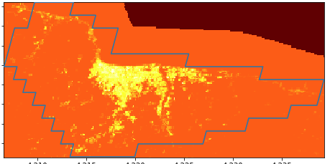
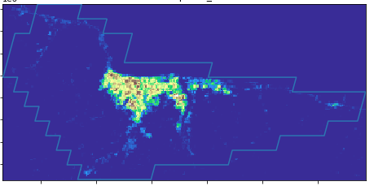
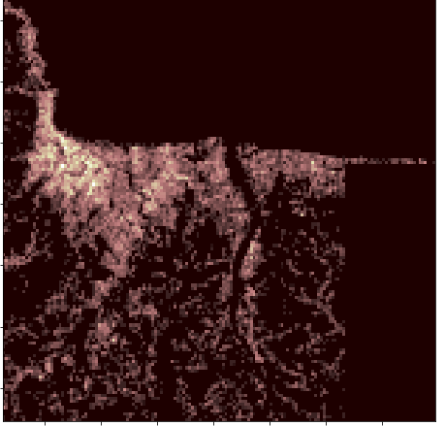
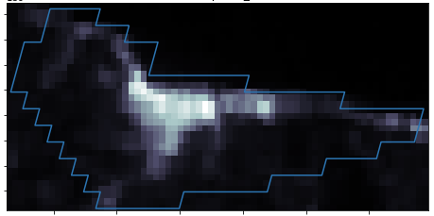
V2 : Non Learnable, Spatial Modifier only
Population
Building Height
Nightlight
Nightlight
Building Density

Slide 24


V2 : Non Learnable, Spatial Modifier only
V1 estimation
V2 estimation

Slide 25

V2 : Non Learnable, Spatial Modifier only
Difference Map :
Population vs Building Height
Green = higher population on lowrise areas
White = correlated
Pink = lower population on highrise areas

Slide 26
Towards V3
f(Total Emission,
Spatial Modifier,
Temporal Modifier)
Spatial Modifier
Emission estimator
Economic indicator
Buildings
Population, Households
GDP, energy source,
Cooking/heating source, …
Area, Height, Type
ML model based on Open street map Buildings (OSMB) and other land use/cover datasets
Microsoft database (unlabeled)
Land use/cover
Total near-real-time CO2 emission
(from carbon monitor database)
Building Prediction
LCZ, human settlement layer, google landcover, …
Spatial res:
100*100 m or 500*500 m
Temporal res:
Daily or weekly
Output
Estimate building height, volume, - and type – using ML
More features : DEM, LCZ, Landcover, LST

Slide 27



OpenStreetMap and OpenStreetMap Buildings
Collaborative free editable geographic database
Major building categories
'skyscraper', 'houseboat', 'sphinx', 'boom', 'university', 'mall', 'prison', 'kindergarten', 'administration', 'control', 'shelter', 'bakery', 'industrial', 'motel', 'service', 'supermarket', 'cooling_tower', 'commercial', 'fashion_store', 'farm', 'office’,
…
OpenStreetMap
2D location and polygon
More detailed building types
OpenStreetMap Buildings
With building heights
Less buildings and less informed building types
Match the building locations
Combine as training set
https://wiki.openstreetmap.org/wiki/Buildings

Slide 28
Building summary
City | MS building | OSM | OSMB | Max(OSM, OSMB) /MS building (%)
Ordu | 18981 | 1930 | 1999 | 10.53158
Manisa | 31191 | 2653 | 2894 | 9.278317
Adana | 198785 | 5493 | 5892 | 2.964006
Trabzon | 22908 | 19059 | 20121 | 87.83394
Cairo | 1958148 | 5336 | 15604 | 0.796875
Johannesburg | 3184909 | 127528 | 123426 | 4.004133

Slide 29




Slide 30



Slide 31



Slide 32



Slide 33



Slide 34



Slide 35




Why
The polygon from OSM and OSMB might be not valid (self-intersection)\

Slide 36




Approach
Find invalid polygon
Try to make a “90 degree” polygon (we assume the buildings corners are mostly 90 degree angle)
Remove duplicated points
Search starts with all pairs of the points
Connect the next point with minimal difference with 90
If we can not find a valid polygon after searching all the possibilities, we use convex hull (the minimal valid convex polygon contains all the points), which might larger than the real building areas.
Fixed
Use convex hull

Slide 37

Simple emission = (density + area*lcz_height)* population
Linear
Equation analogized from economic production function
C ~ $P^{β_{P}}A^{β_{A}}$
Log C ~ $β_{P}$log(P) + $β_{A}$log(A) + $β_{C}$log(P)log(A)
None Linear

Slide 38
Compare/evaluate for some meaningful areas

